Slide 1
Recap
We went over the principles of data analysis
Define the Objective
Collect the data
Explore and understand the data
Data cleaning
Transform the data
Analyze the Data
Interpret the results

Slide 2
Recap
We learned ways to use pandas
Access columns
data_frame[[‘list_of_columns’]]
Access rows
data_frame.loc[[“index_of_choice”] *special cases
Top of the data frame
data_frame.head()
Get rid of useless data
data_frame.dropna(axis=1)
Check the shape of the data frame
data_frame.shape
Access the index
data_frame.index

Slide 3
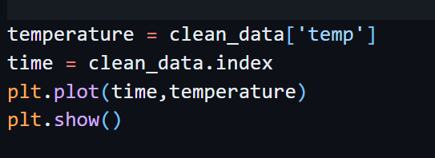
Recap
We began to use matplotlib to gain an understanding of the data
Most basic plot needs elements in the x axis and elements in the y axis

Slide 4
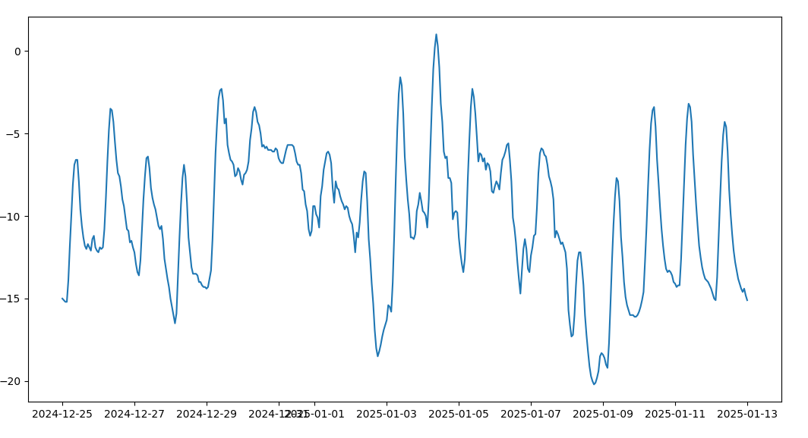
Plotting

Slide 5
Plotting
This is a really bad plot!
Why?

Slide 6
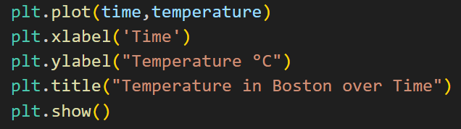
Plotting
A good plot needs to be easily understood by anyone
LABELS are crucial!!

Slide 7
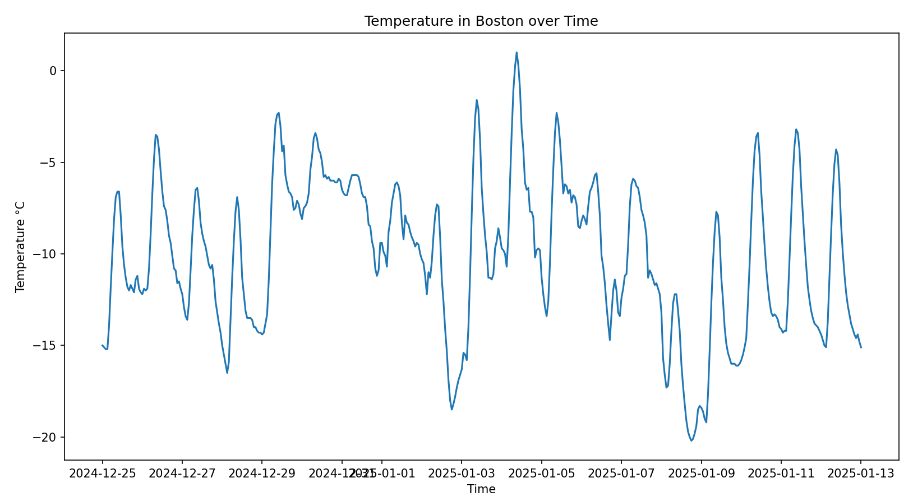
Plotting

Slide 8
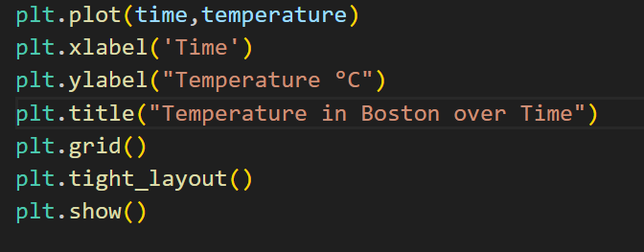
Plotting
Extra improvements that I like to make

Slide 9
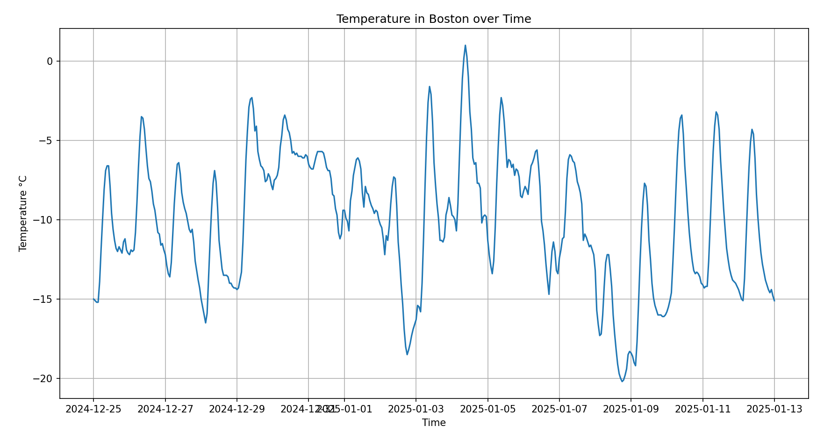
Plotting

Slide 10
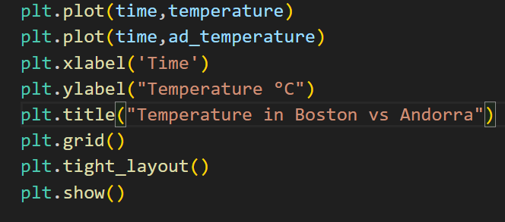
Plotting two curves
We can choose to plot more curves in the same image and compare them

Slide 11
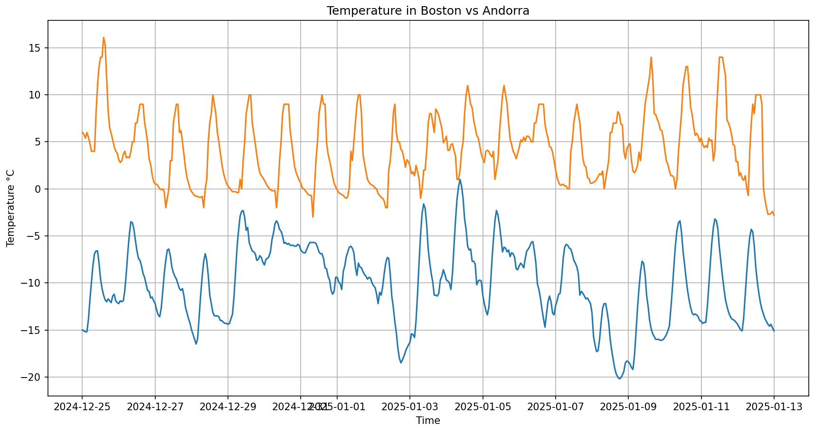
Plotting two curves

Slide 12
Plotting Two Curves
This plot is not very good either
It’s missing something crucial

Slide 13
Plotting Two Curves
This plot is not very good either
It’s missing something crucial
LABELS

Slide 14
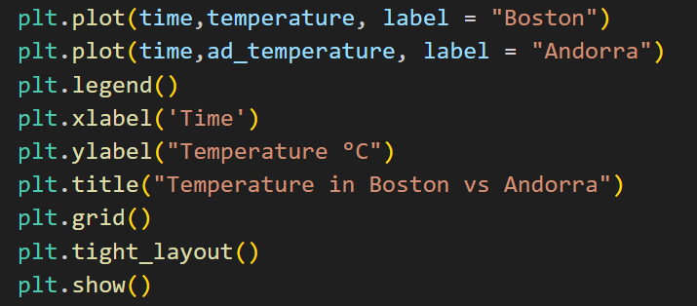
Plotting Two Curves
This plot is not very good either
It’s missing something crucial
LABELS

Slide 15
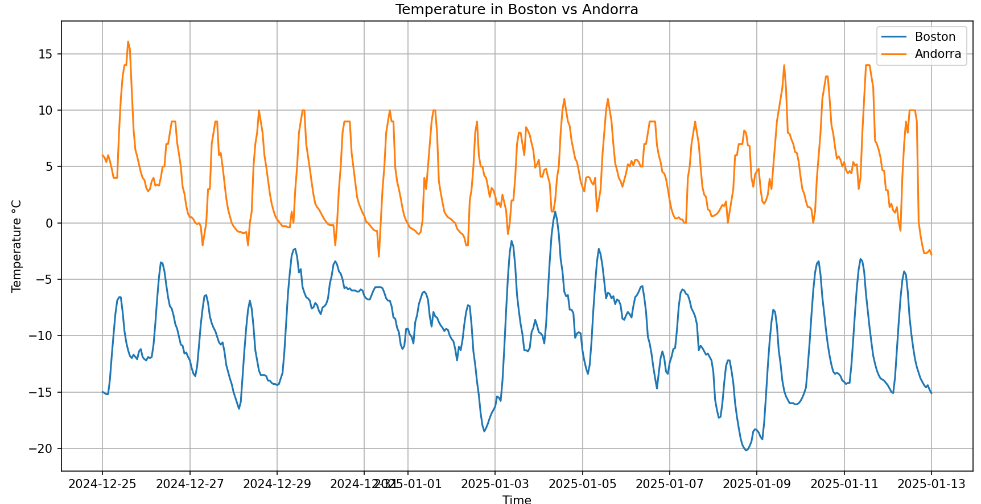
Plotting Two curves

Slide 16

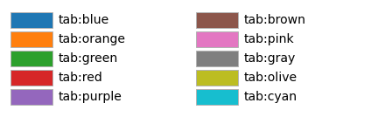
Customizing plots
Maybe you associate Andorra with another color, yellow maybe?
In matplotlib there are multiple base colors

Slide 17
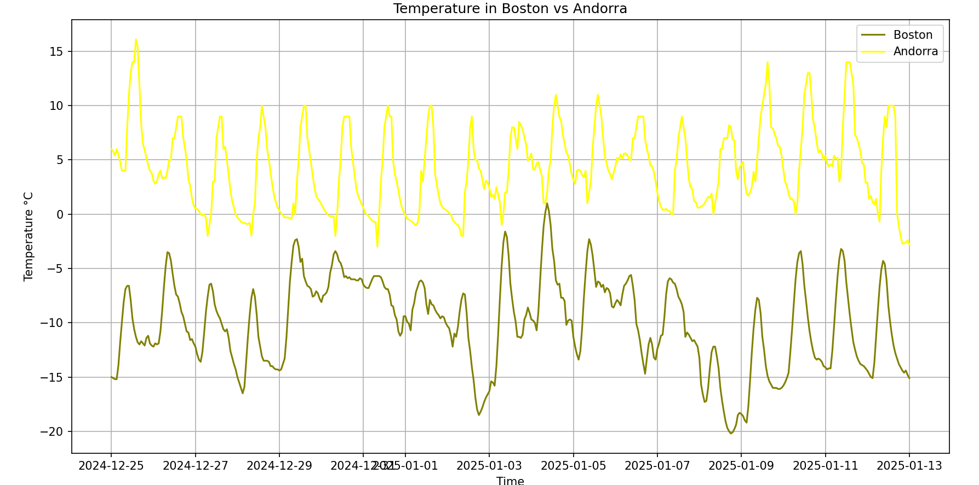
Plotting Two Curves

Slide 18
Exercise
Using meteostat, choose a location in spain, and get the weather data from July 1st 2023 to January 1st 2025
Remember how we input dates and coordinates into meteostat
Clean the data
Get the wind data from the first week of 2024
Plot it over time

